Slide 1

Industrial Energy Monitoring System
A robust IIoT solution using RS-485 and Direct Telegram Reporting
Team Members:
Safwan Sayyad – 312066
Akshaa Khekale – 312058
Sai Trisha – 312060
Isha Gandewar – 312061

Slide 2
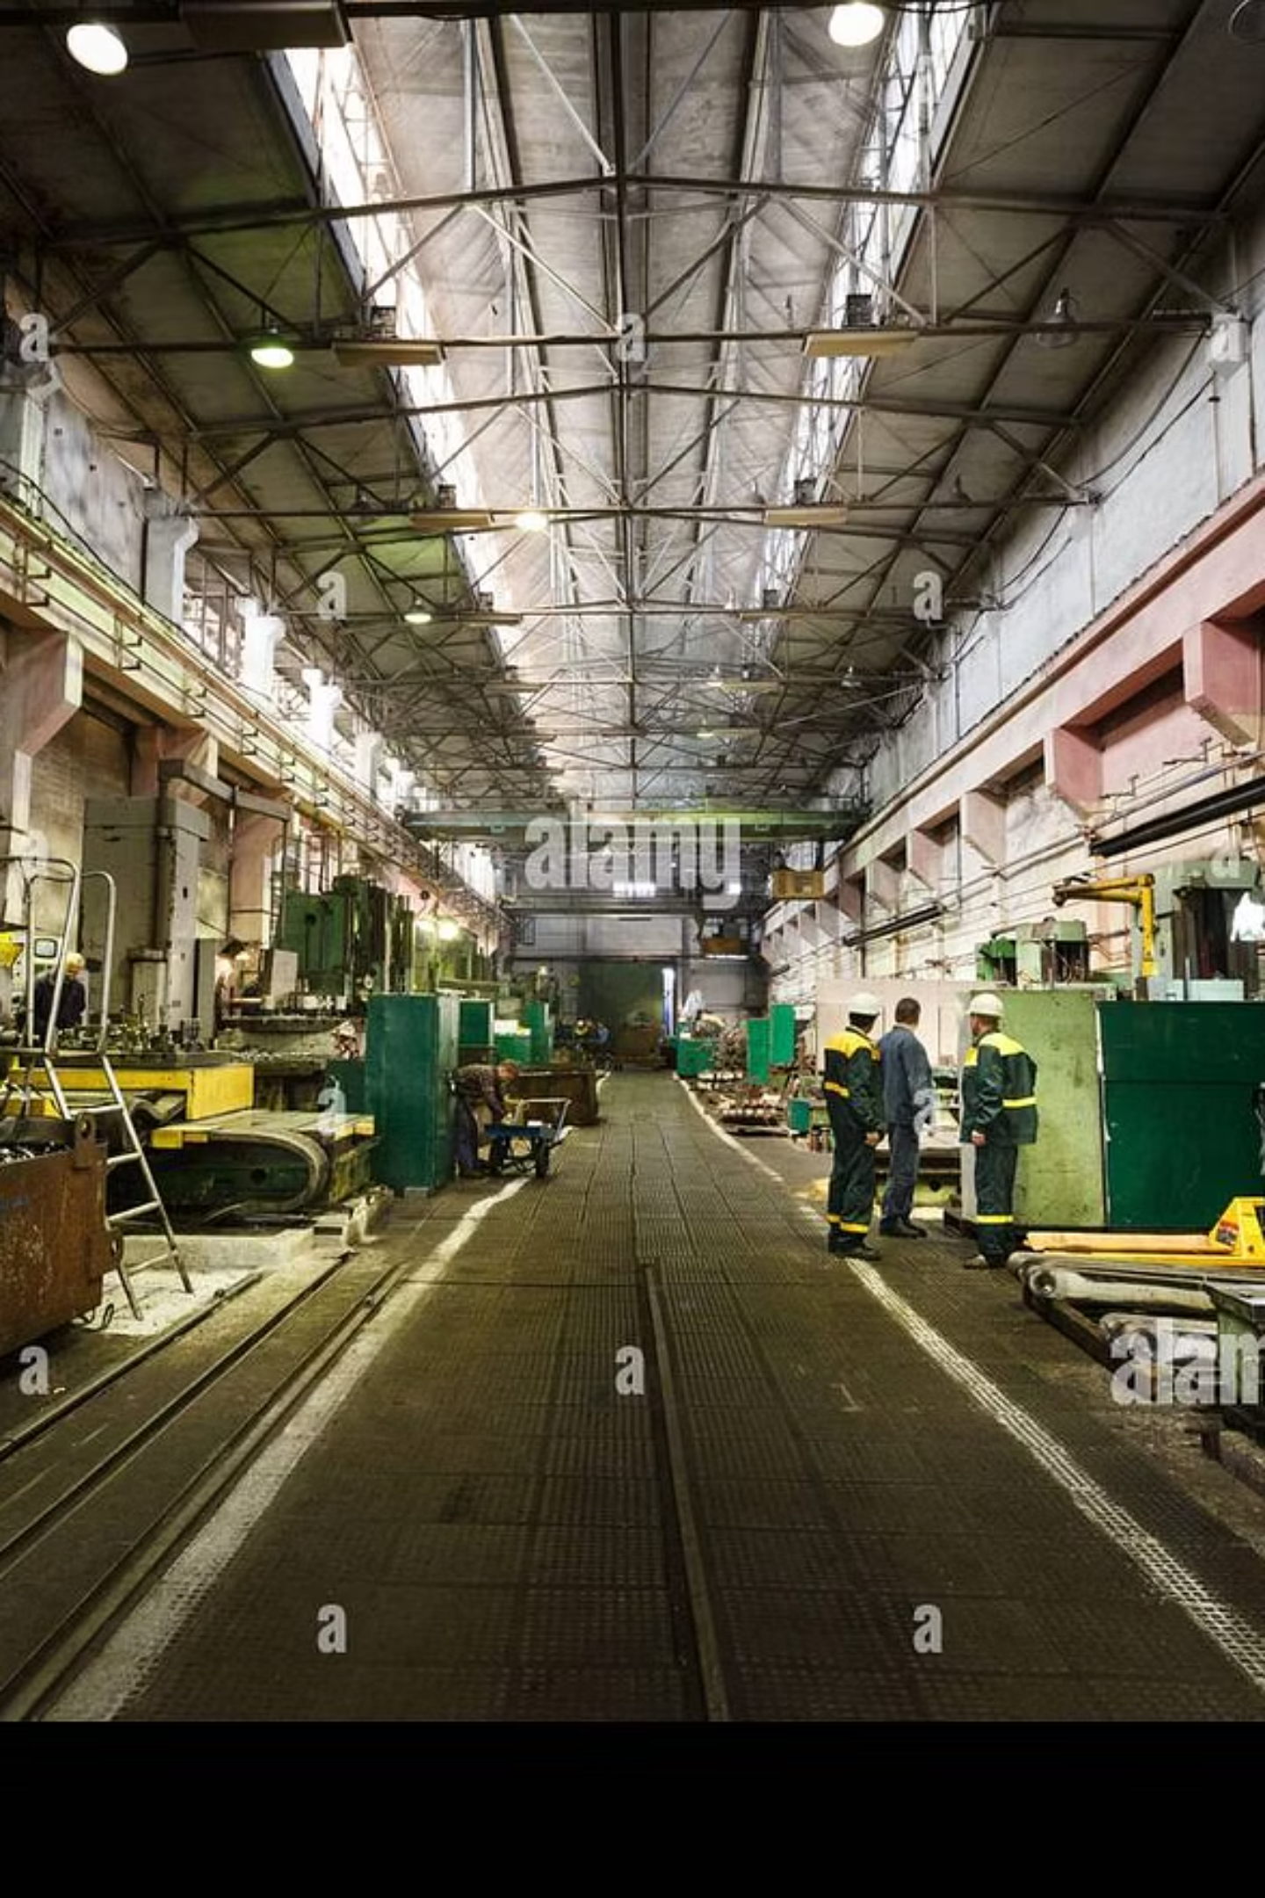
Challenges in Traditional Monitoring
Signal Integrity: Standard TTL signals degrade over long distances in factories.
EMI Noise: Heavy motors generate electromagnetic interference that corrupts data.
Safety Risks: Direct connection to high-voltage machinery endangers personnel.
Lack of Visibility: Manual logging prevents immediate detection of faults like over-voltage.

Slide 3
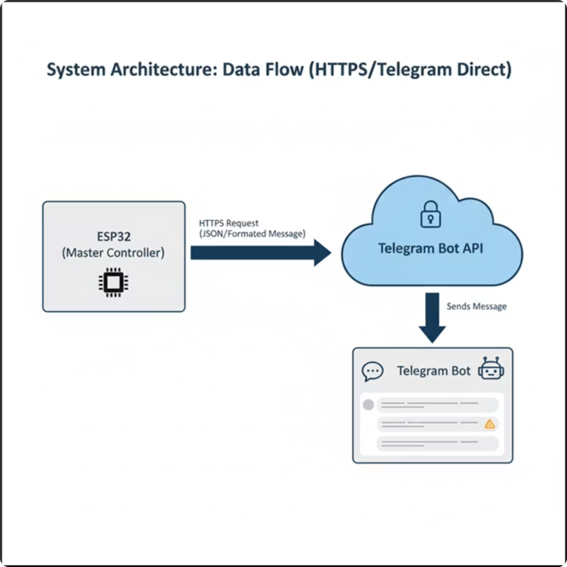
Robust IIoT Architecture
RS-485 Standard: Ensures noise-immune, long-distance data transfer (up to 1200m).
ESP32 Gateway: Acts as the Master Controller processing Modbus data.
Telegram Integration: Sends real-time alerts directly to mobile via secure HTTPS.
Safety: Optical isolation provided by industrial sensors.

Slide 4

System Components
ESP32 DevKit V1
1
Master Controller, Dual-Core 240 MHz, handles Modbus & HTTPS.
PZEM-004T V3.0
2
Measures RMS Voltage, Current, Power, and Energy with optical isolation.
MAX485 Transceiver
3
Converts UART signals to Differential RS-485 signals for noise rejection.

Slide 5
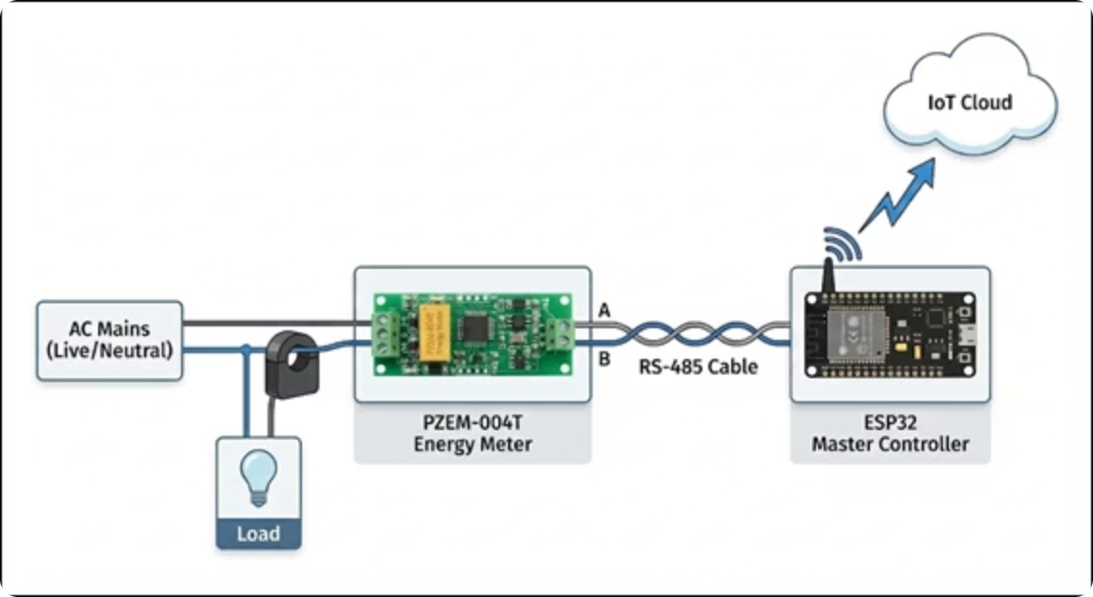
How It Works
01
Field Layer
PZEM sensors measure High Voltage AC mains.
02
Transport Layer
MAX485 converts signals; ESP32 requests data using Modbus RTU protocol.
03
Cloud Layer
ESP32 compiles JSON payload and sends HTTPS POST requests.
04
User Interface
Telegram Bot receives data and displays alerts (High Voltage/Current).

Slide 6

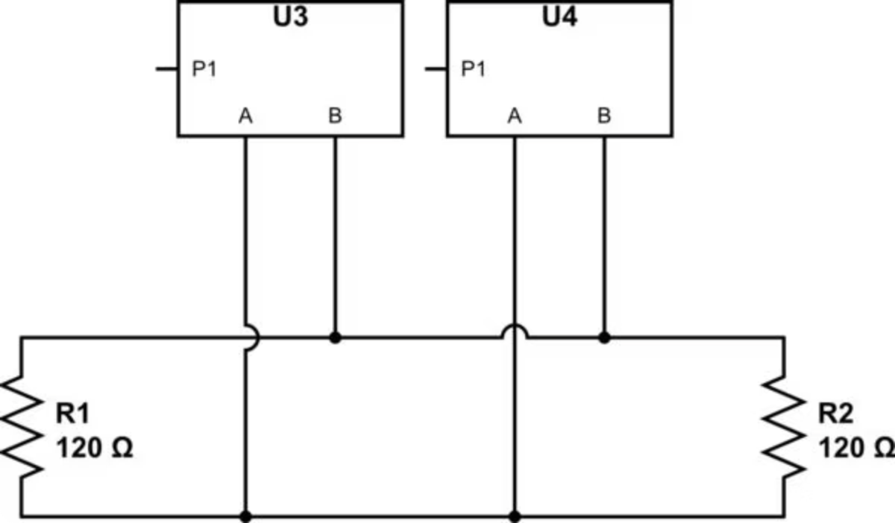
Communication Protocols
Differential Signaling: Data uses voltage difference between Line A and Line B to reject common-mode noise.
Modbus RTU: ESP32 acts as Master, polling sensors (Slave ID 0xF8) for 10 registers.
Data Processing: Bitwise operations reconstruction 32-bit integers for Power and Energy values.

Slide 7
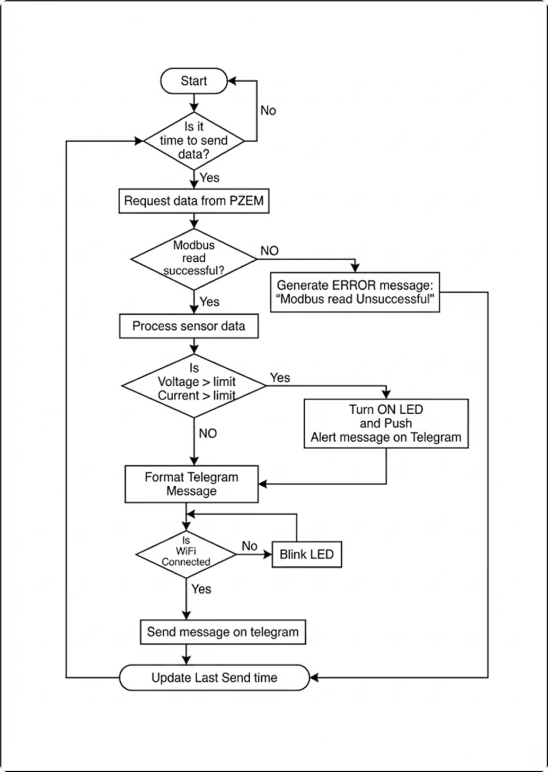




Intelligent Monitoring Logic
Threshold Checks
Firmware validates if Voltage > 250V or Current > 20A.
Local Alert
GPIO 25 triggers a physical Warning LED.
Cloud Alert
Immediate "HIGH VOLTAGE ALERT" message sent to Telegram.
Routine Reporting
Periodic energy reports sent every 15 seconds.

Slide 8
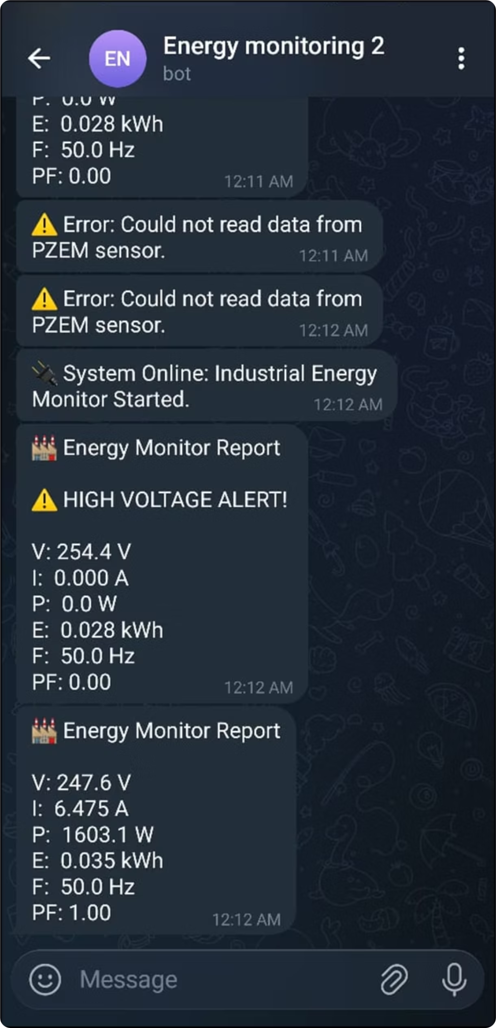
Project Outcomes
Reliable Data: Successfully achieved noise-immune acquisition using RS-485.
Real-Time Reporting: Instant telemetry (Voltage, Current, Power, PF) on Telegram.
Scalability: The system bypasses complex brokers for a direct, efficient link.
Key Output: Sample reading of 247.6V and 1603W captured successfully.

Slide 9

Thank You

